Slide 1
Mathematical Preliminaries
Introduction to Deep Learning
Module 1, Class 2

Slide 2
Agenda
Introduction to derivatives in one dimension
Calculating derivatives using numerical approximation
Product rule, Quotient rule, Chain rule
Properties of derivatives
Derivatives and Optimization
Gradient descent
Introduction to Integration

Slide 3
Pre-read materials
The Essence of Calculus video series by 3Blue1Brown (esp. episodes 1–5: derivative intuition, chain rule, optimization) — extremely effective for intuition.
Paul’s Online Math Notes: Sections 3.1 - 3.6, and section 3.9
Explained.ai : Review Scalar derivative rules section
Blog post: “Gradient Descent Demystified

Slide 4
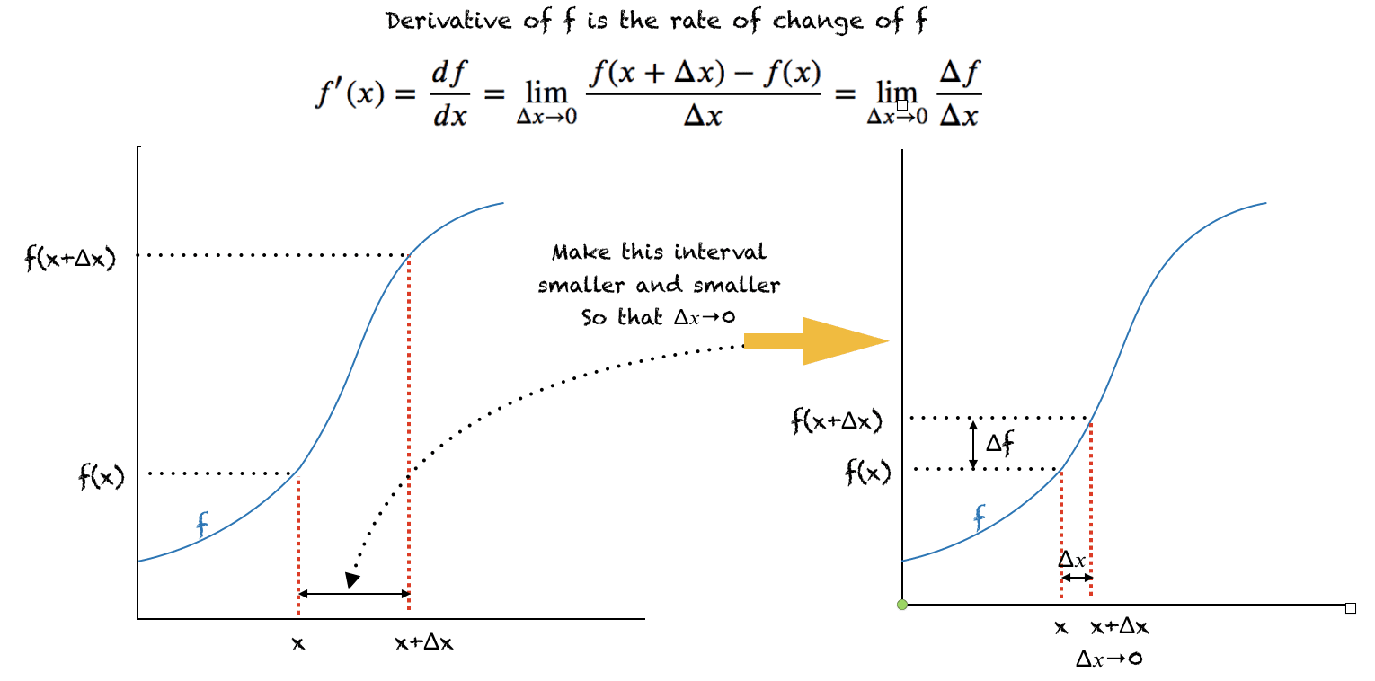

Derivatives in one dimension
As gets smaller, the derivative approximates the slope of the tangent where the derivative is calculated
Notes:
Derivative of a function is itself a function of x!

Slide 5
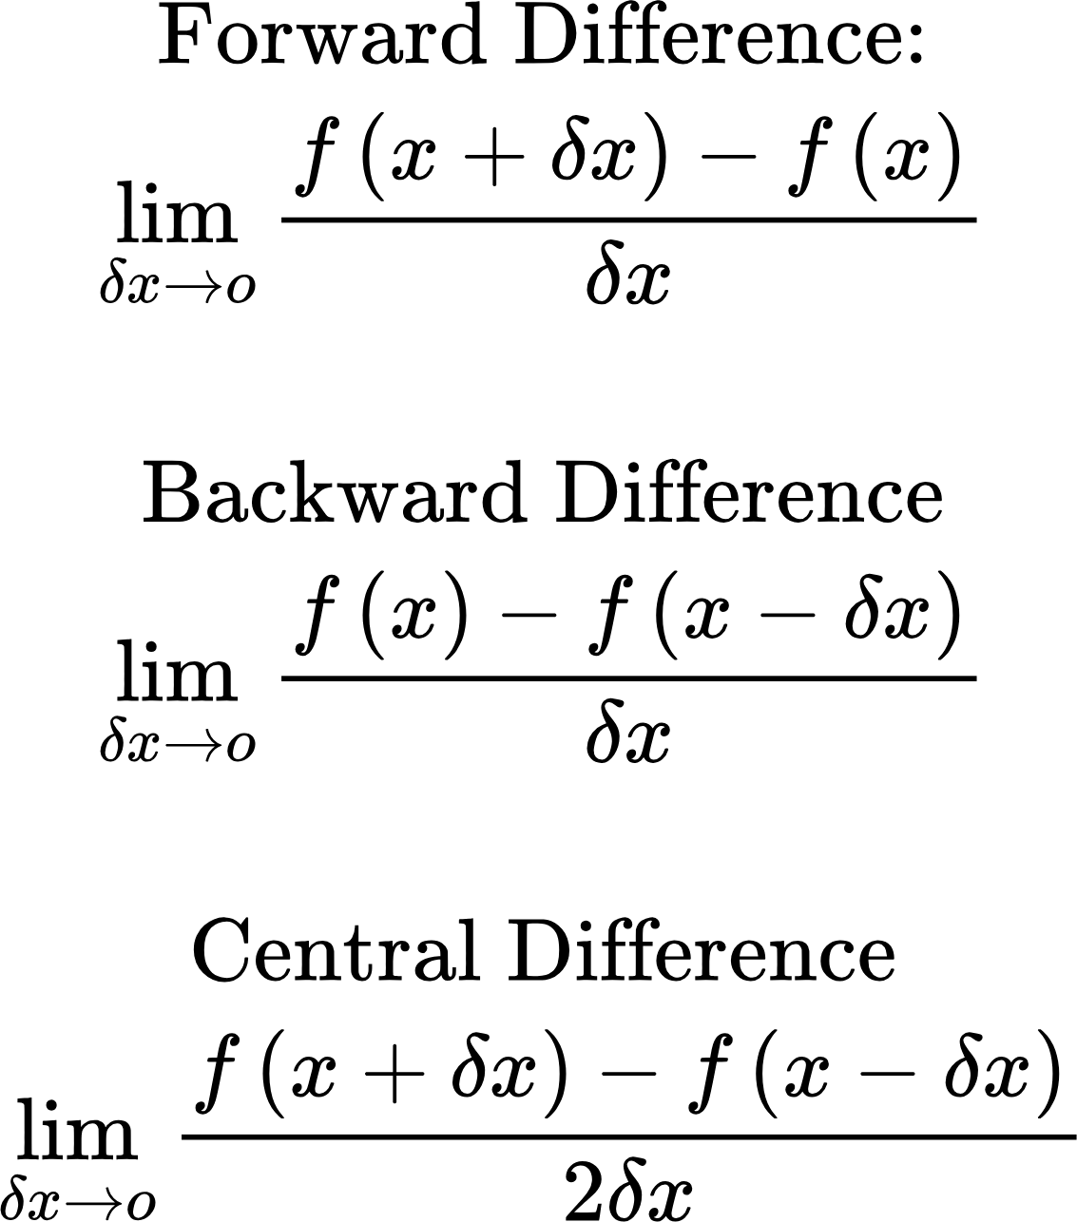
Derivatives in one dimension: Forward, Backward, Central Difference
Central difference is preferred for manual (finite difference) calculation of the derivative
Notes:
Derivative of a function is itself a function of x!

Slide 6
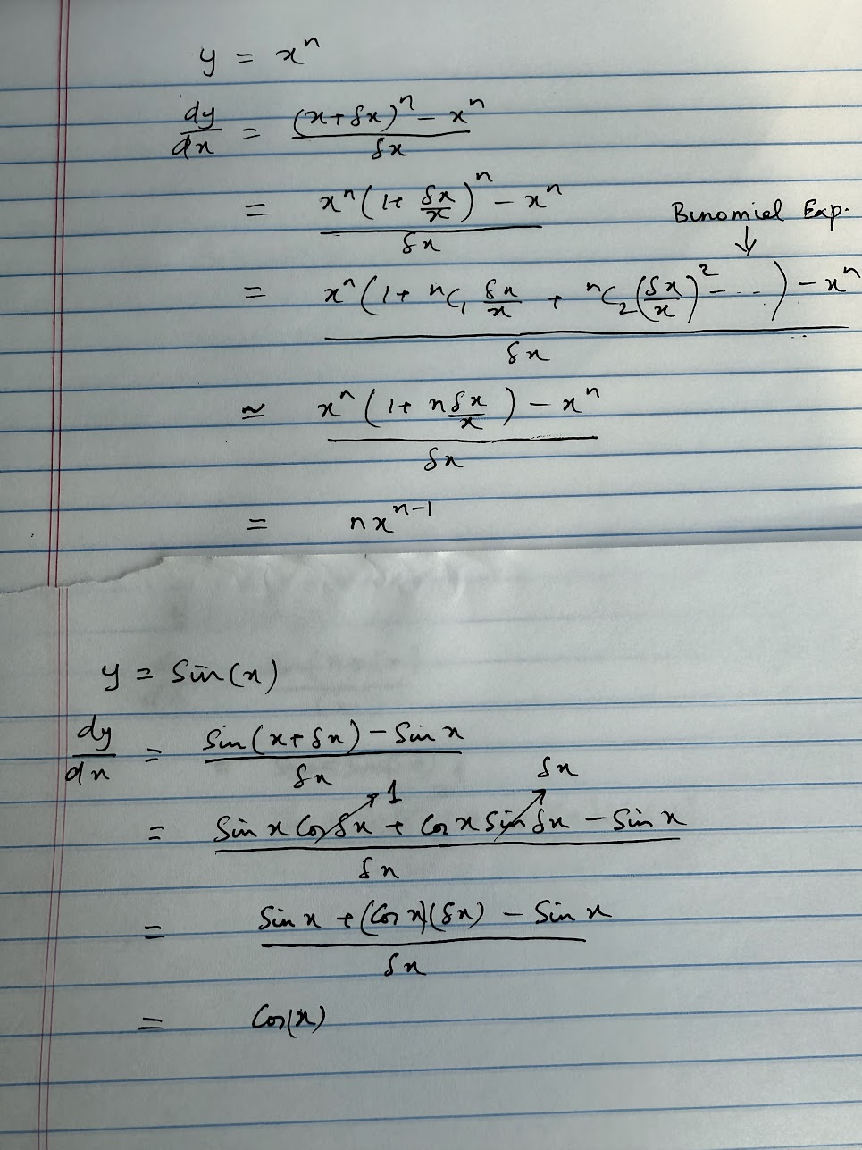
Derivatives: Some examples..
delta_x: 0.00, derivative: 4.00
delta_x: 0.05, derivative: 4.31
delta_x: 0.10, derivative: 4.64
delta_x: 0.15, derivative: 4.99
delta_x: 0.00, derivative: 2.00
delta_x: 0.05, derivative: 2.05
delta_x: 0.10, derivative: 2.10
delta_x: 0.15, derivative: 2.15
Intuition:
Derivative approximation becomes less accurate as delta_x increases
Derivative approximation becomes less accurate more quickly for faster changing functions..
Code: simple_derivatives.py

Slide 7
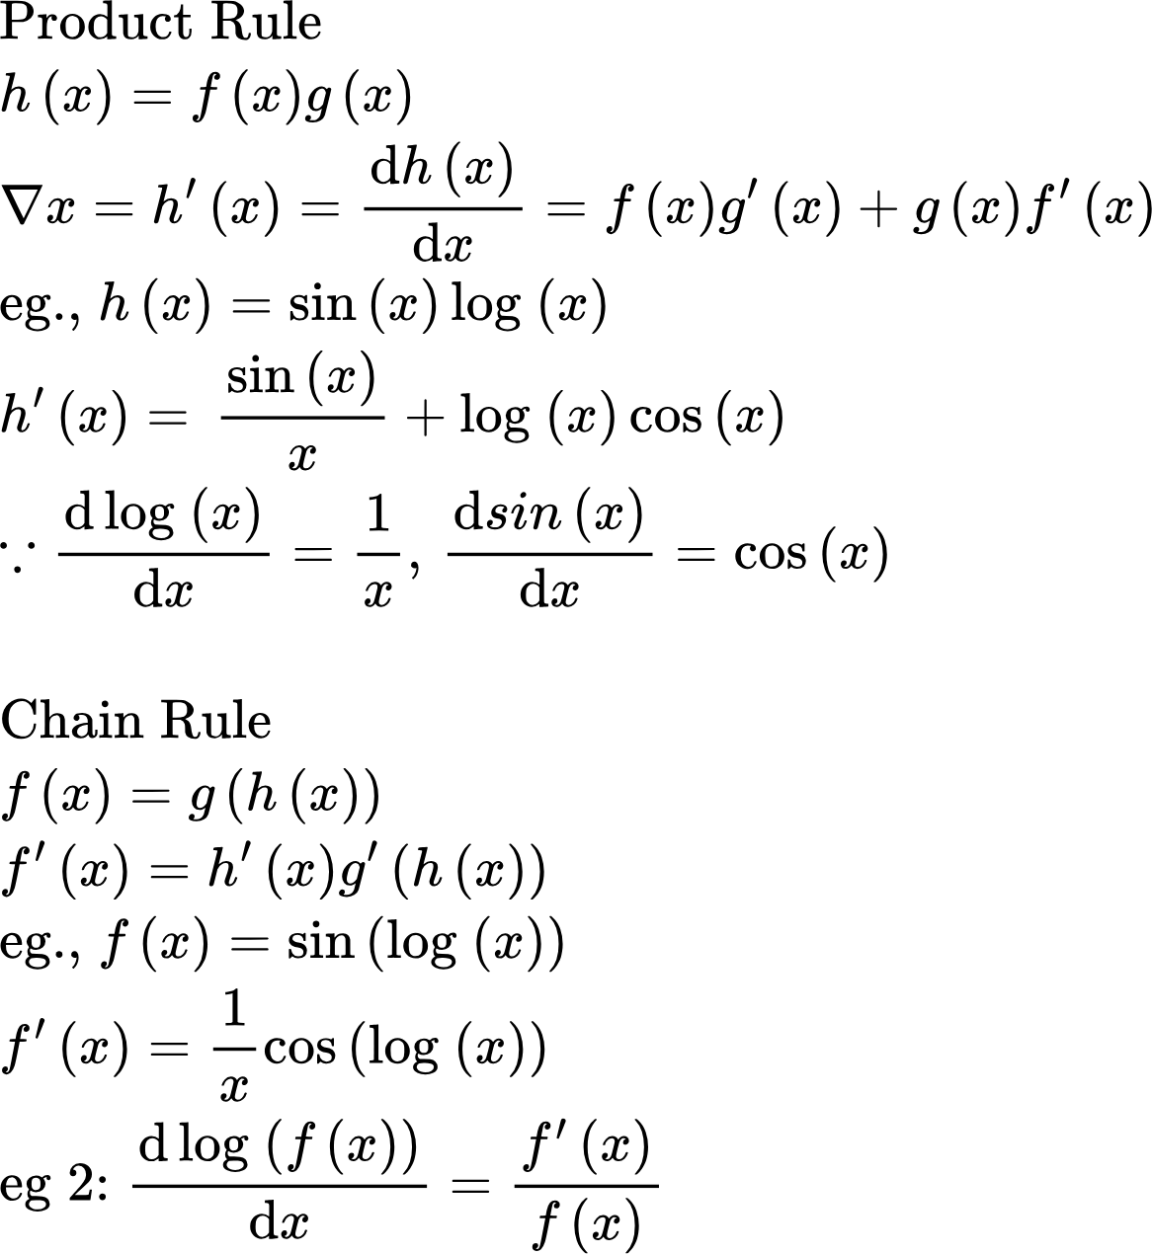
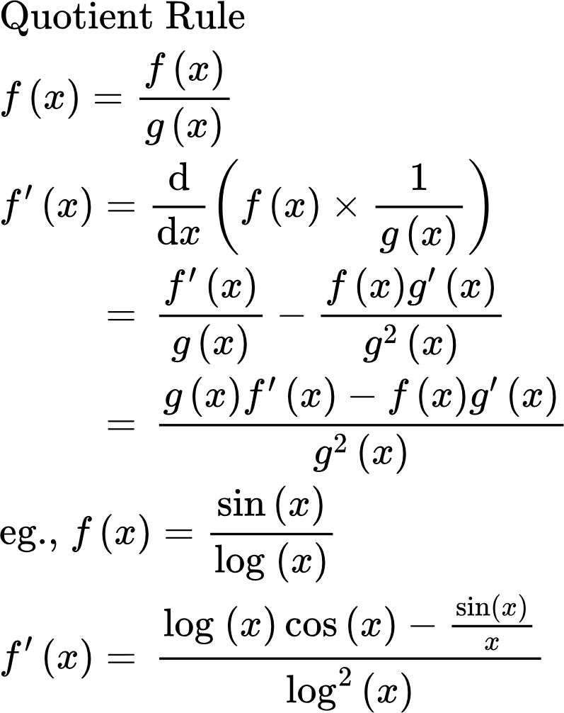
Derivatives
Code: simple_derivatives.py
Notes:
Talk about notation..

Slide 8
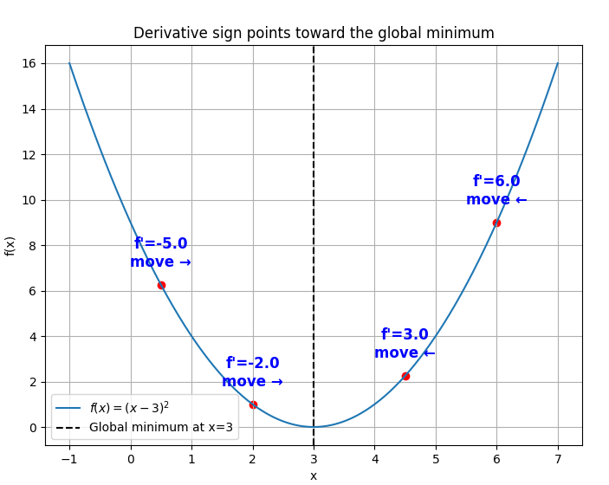
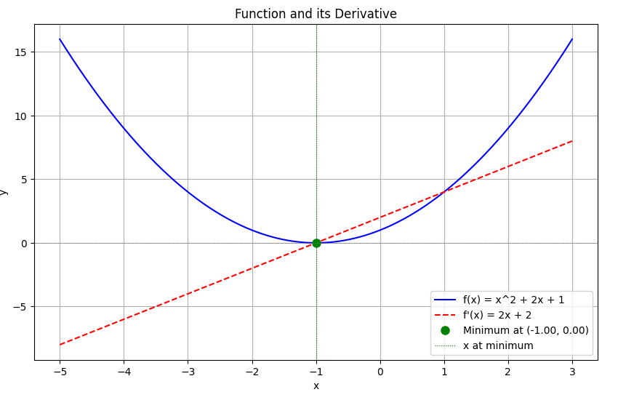
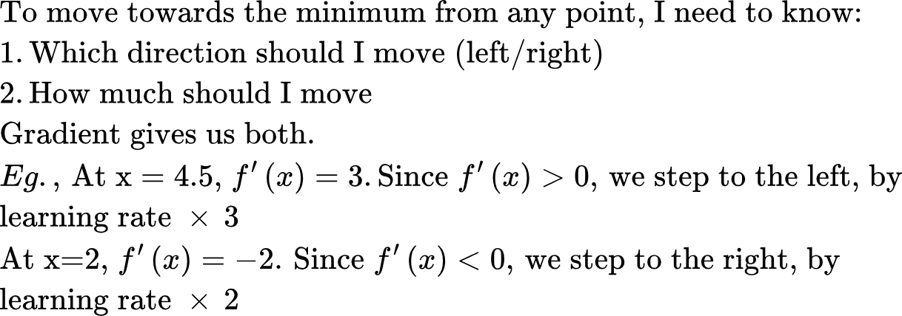
Derivative: Important property
Derivative points in the opposite direction of the minimum. Thus if start somewhere and move in the direction of the negative gradient, we’ll eventually hit the minimum.
At the minimum, the derivative is 0. Makes sense, because derivative of a function at a point is the slope of the function at that point, and the slope must be zero. Note: slope can be zero both at a minima and maxima! So how to we tell them apart? Second derivative test!
Code: multiple_local_minima.py, derivative_direction.py

Slide 9
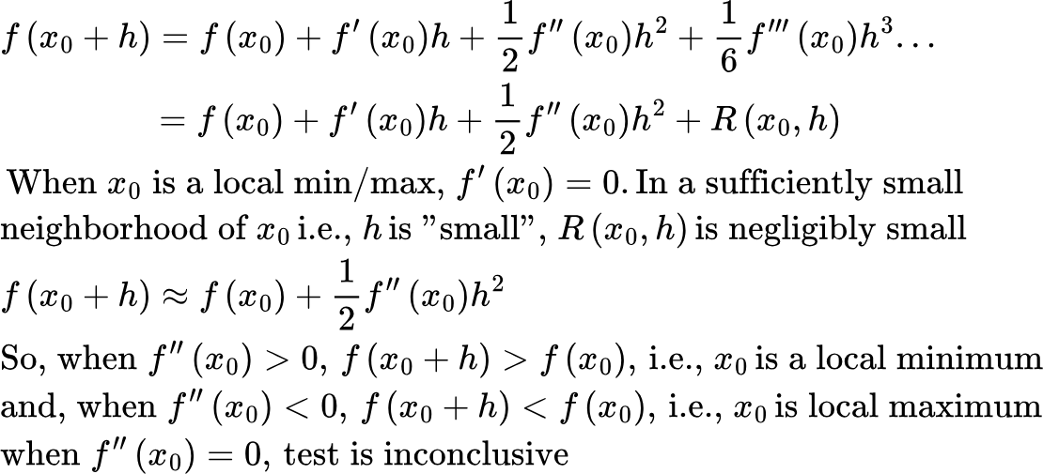
Second derivative test
For some functions (eg., sin(x), log(x)) all higher order derivatives exist. For others, only derivatives up to a certain order exist (x^n) and higher order derivatives are zero..

Slide 10
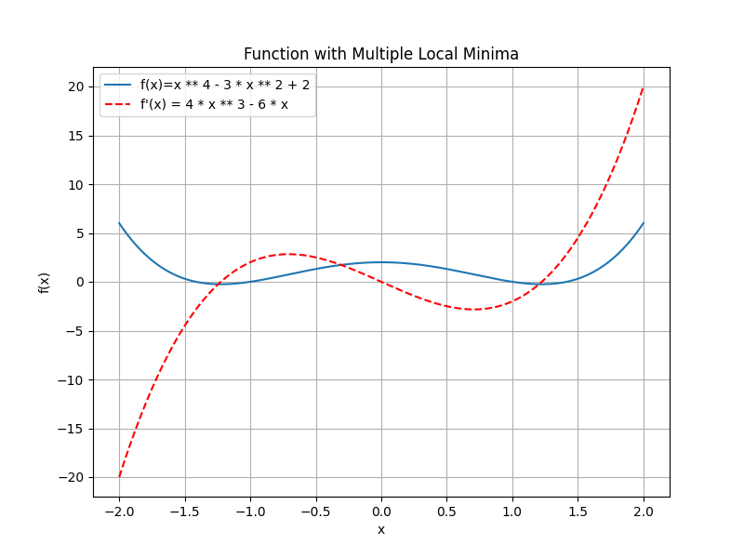
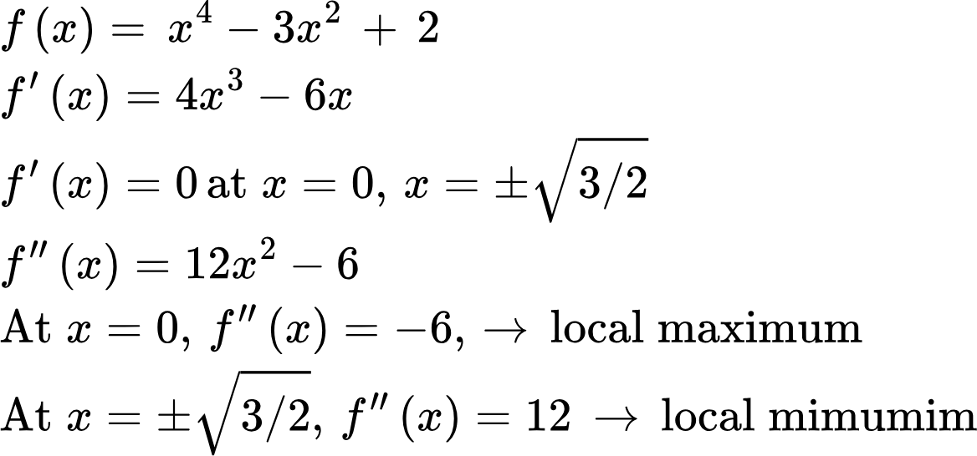
Derivative: Important property
A function can have many local minima or maxima! We can distinguish between minimum and maximum using the second derivative test.
Sometimes, we can analytically solve f_prime(x) = 0, but usually not.
Code: multiple_local_minima.py

Slide 11
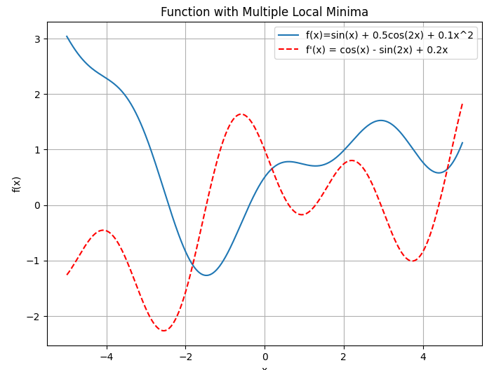
Derivative: Important property
In this case below, we can’t easily solve for f_prime(x) = 0

Slide 12
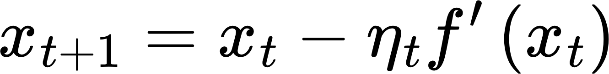
Optimization using Gradient Descent
Process of finding a minimum by starting at a guess, and moving in the direction of the negative gradient.
Learning rate
Gradient at current iterate
Key points:
Gradient points in the direction of maximum ascent, that’s why we move against the gradient
The step size is a combination of learning rate and current value of the gradient
Gradient provides both direction and size of the step. However, it is common to decrease the learning rate as we approach the minimum

Slide 13
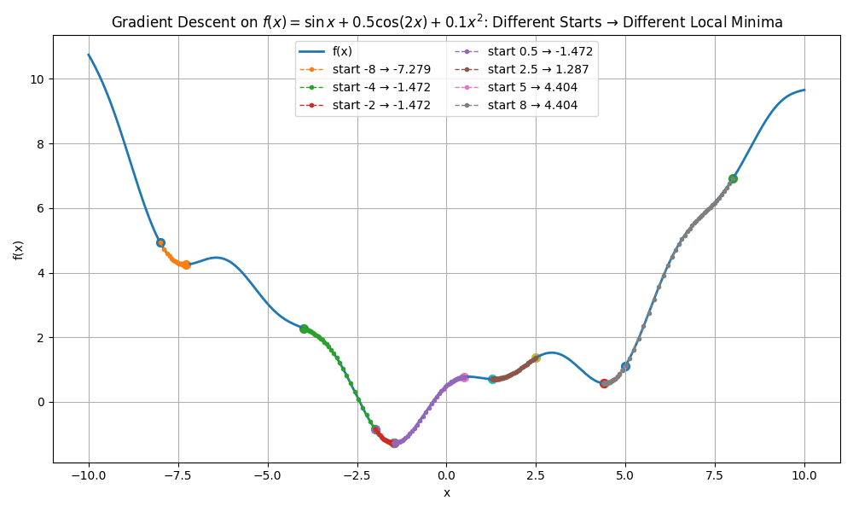
Optimization using Gradient Descent
Process of finding a minimum by starting at a guess, and moving in the direction of the negative gradient.
Learning rate
Gradient at current iterate

Slide 14
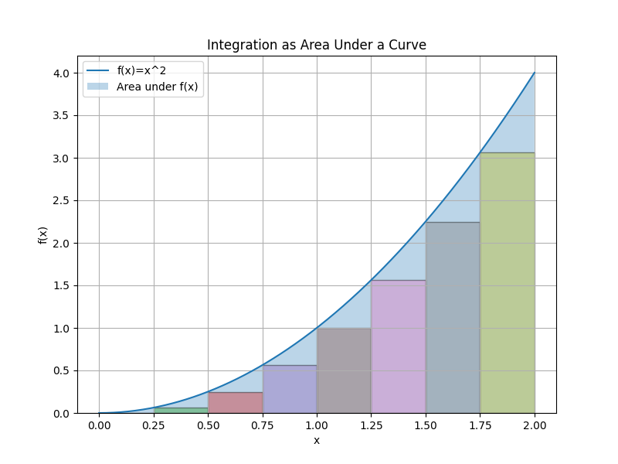
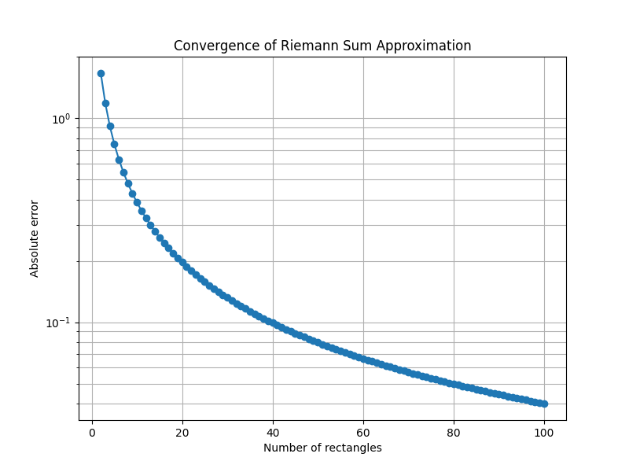
Integration
Integrating a function from a to b means calculating the area under the curve defined by the function
Code: integration_demo.py

Slide 15
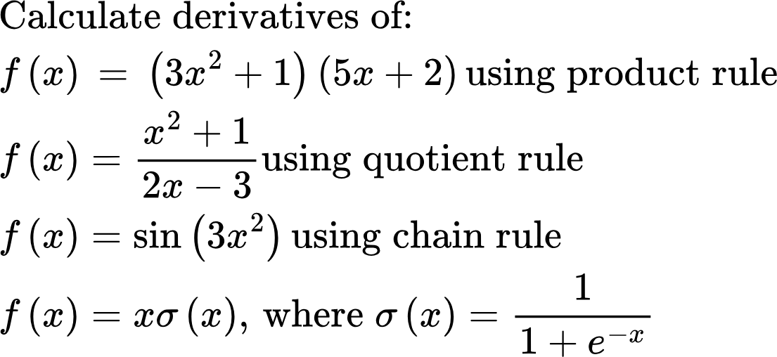
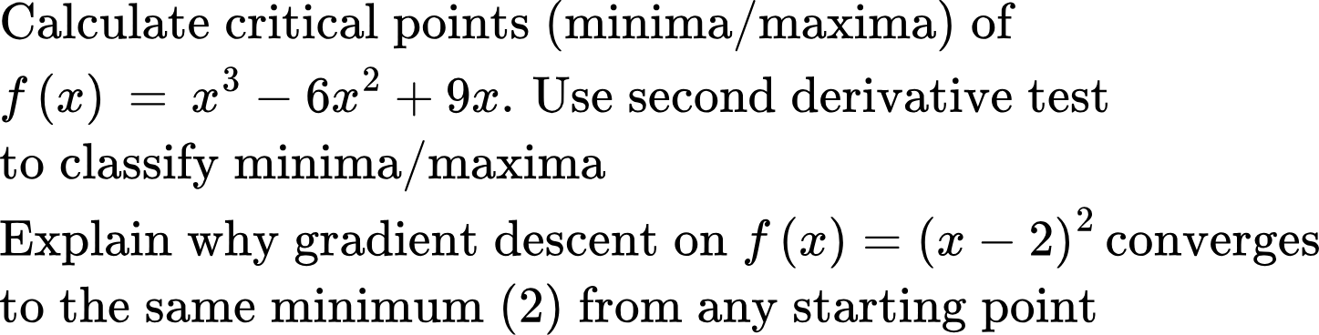
Homework problems
Derivative Rules
Optimization

Slide 16
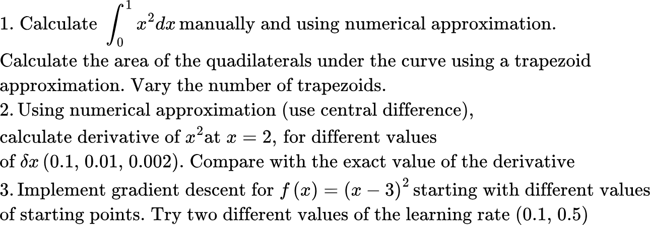
Homework problems
Coding Problems

